Slide 1
CHW Reimbursement Model: South Dakota
An introduction to Community Health Workers and South Dakota Medicaid Reimbursement for CHWs in South Dakota

Slide 2
What is a CHW? American Public Health Association (APHA)
The CHWSD and the South Dakota Department of Health have adopted the American Public Health Association’s (APHA) definition of a Community Health Worker (CHW):
“A Community Health Worker (CHW) is a frontline public health worker who is a trusted member of and/or has an unusually close understanding of the community served. This trusting relationship enables the worker to serve as a liaison/link/intermediary between health/social services and the community to facilitate access to services and improve the quality and cultural competence of service delivery.”
- APHA 2020¹

Slide 3
Community Health Worker Scope of Work

Slide 4
CHW Scope of Work South Dakota-specific²
Health system navigation and resource coordination, including helping a patient find providers to receive a service, helping a patient make an appointment for a service, arranging transportation to a medical appointment, attending an appointment with the patient for a medical service, and helping a patient find other relevant community resources such as a support group.
Health promotion and coaching, including providing information or education to patients that makes positive contributions to their health status, such as cessation of tobacco use, reduction in the misuse of alcohol or drugs, improvement in nutrition, improvement of physical fitness, family planning, control of stress, pregnancy and infant care including prevention of fetal alcohol syndrome.
Health education to teach or promote methods and measures that have been proven effective in avoiding illness and/or lessening its effects, such as immunizations, control of high blood pressure, control of sexually transmittable disease, prevention and control of diabetes, control of toxic agents, occupational safety and health, and accident prevention. The content of the education must be consistent with established or recognized healthcare standards.

Slide 5
Qualifying Conditions For SD DSS Medicaid CHW Services²
Asthma
Cancer
COPD
Depression
Diabetes
Heart Disease
High Blood Pressure
High Cholesterol
Mental Health Conditions
Obesity
Musculoskeletal and neck/back disorders
Prediabetes
High Risk Pregnancy
Substance Use Disorder
Tobacco use
Use of multiple medications (6 or more classes of drugs)

Slide 6
Qualifying Barriers For SD DSS Medicaid CHW Services²
Geographic distance from health services results in inability to attend medical appointment or pick-up prescriptions; or
Lack of phone results in the individual going to the emergency department instead of scheduling a medical appointment; or
Cultural/language communication barriers results in the individual not following a medical professional’s recommendation.

Slide 7
CHW Scope of Work Medicaid-specific²
Health system navigation and resource coordination, including helping a recipient find Medicaid providers to receive a covered service, helping a recipient make an appointment for a Medicaid covered service, arranging transportation to a medical appointment, attending an appointment with the recipient for a covered medical service, and helping a recipient find other relevant community resources such as support groups.
Health promotion and coaching, including providing information or education to recipients that makes positive contributions to their health status, such as cessation of tobacco use, reduction in the misuse of alcohol or drugs, improvement in nutrition, improvement of physical fitness, family planning, control of stress, pregnancy and infant care including prevention of fetal alcohol syndrome.
Health education to teach or promote methods and measures that have been proven effective in avoiding illness and/or lessening its effects, such as immunizations, control of high blood pressure, control of sexually transmittable disease, prevention and control of diabetes, control of toxic agents, occupational safety and health, and accident prevention. The content of the education must be consistent with established or recognized healthcare standards.

Slide 8
Reimbursement Rates
CPT Code | Rate* | Service Type
98960 | $20.89 | 1 patient, 1 unit
98961 | $10.44 | 2-4 patients, 1 unit
98962 | $7.31 | 5-8 patients, 1 unit
CHW Services are provided in units.
1 Unit = 30 Minutes (16 - 45 minutes of service)
2 Units = 60 Minutes (46 or more minutes of service
$41.78 per hour
Limitations
Limit 2 Units of service per day
104 Units of service per year
*Updated July 1, 2021

Slide 9
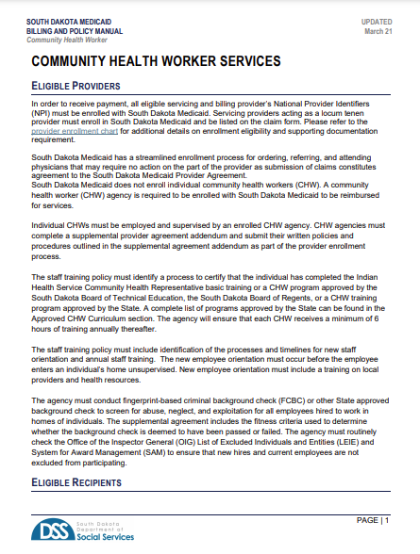
Additional Requirements SD DSS Medicaid Reimbursement
CHW Services must be provider ordered.
Individual CHWs must be employed and supervised by an enrolled CHW agency.
CHW agencies must complete a supplemental provider agreement addendum and submit their written policies and procedures.
CHWs must have completed training through an approved SD DSS Medicaid CHW training program.
See Billing and Policy Manual for complete information.
Notes:
See billing and policy manual for all information regarding an organization receiving CHW reimbursements

Slide 10
Training Programs Certificate-Level and Specified Training Programs
Certificate-Level Training Programs
16-17 credits
1 semester in length (approx. 450 hours)
3 (soon to be 4) training programs
Indian Health Service Community Health Representative (CHR) training program (grandparented in)
Specified Training Programs
Family Spirit® Home Visiting Program (Tribal Home Visiting Program)
National Diabetes Prevention Program (Lifestyle Coach Training)
Better Choices, Better Health® SD (Lay Leader Training)
Additional training programs may be added

Slide 11
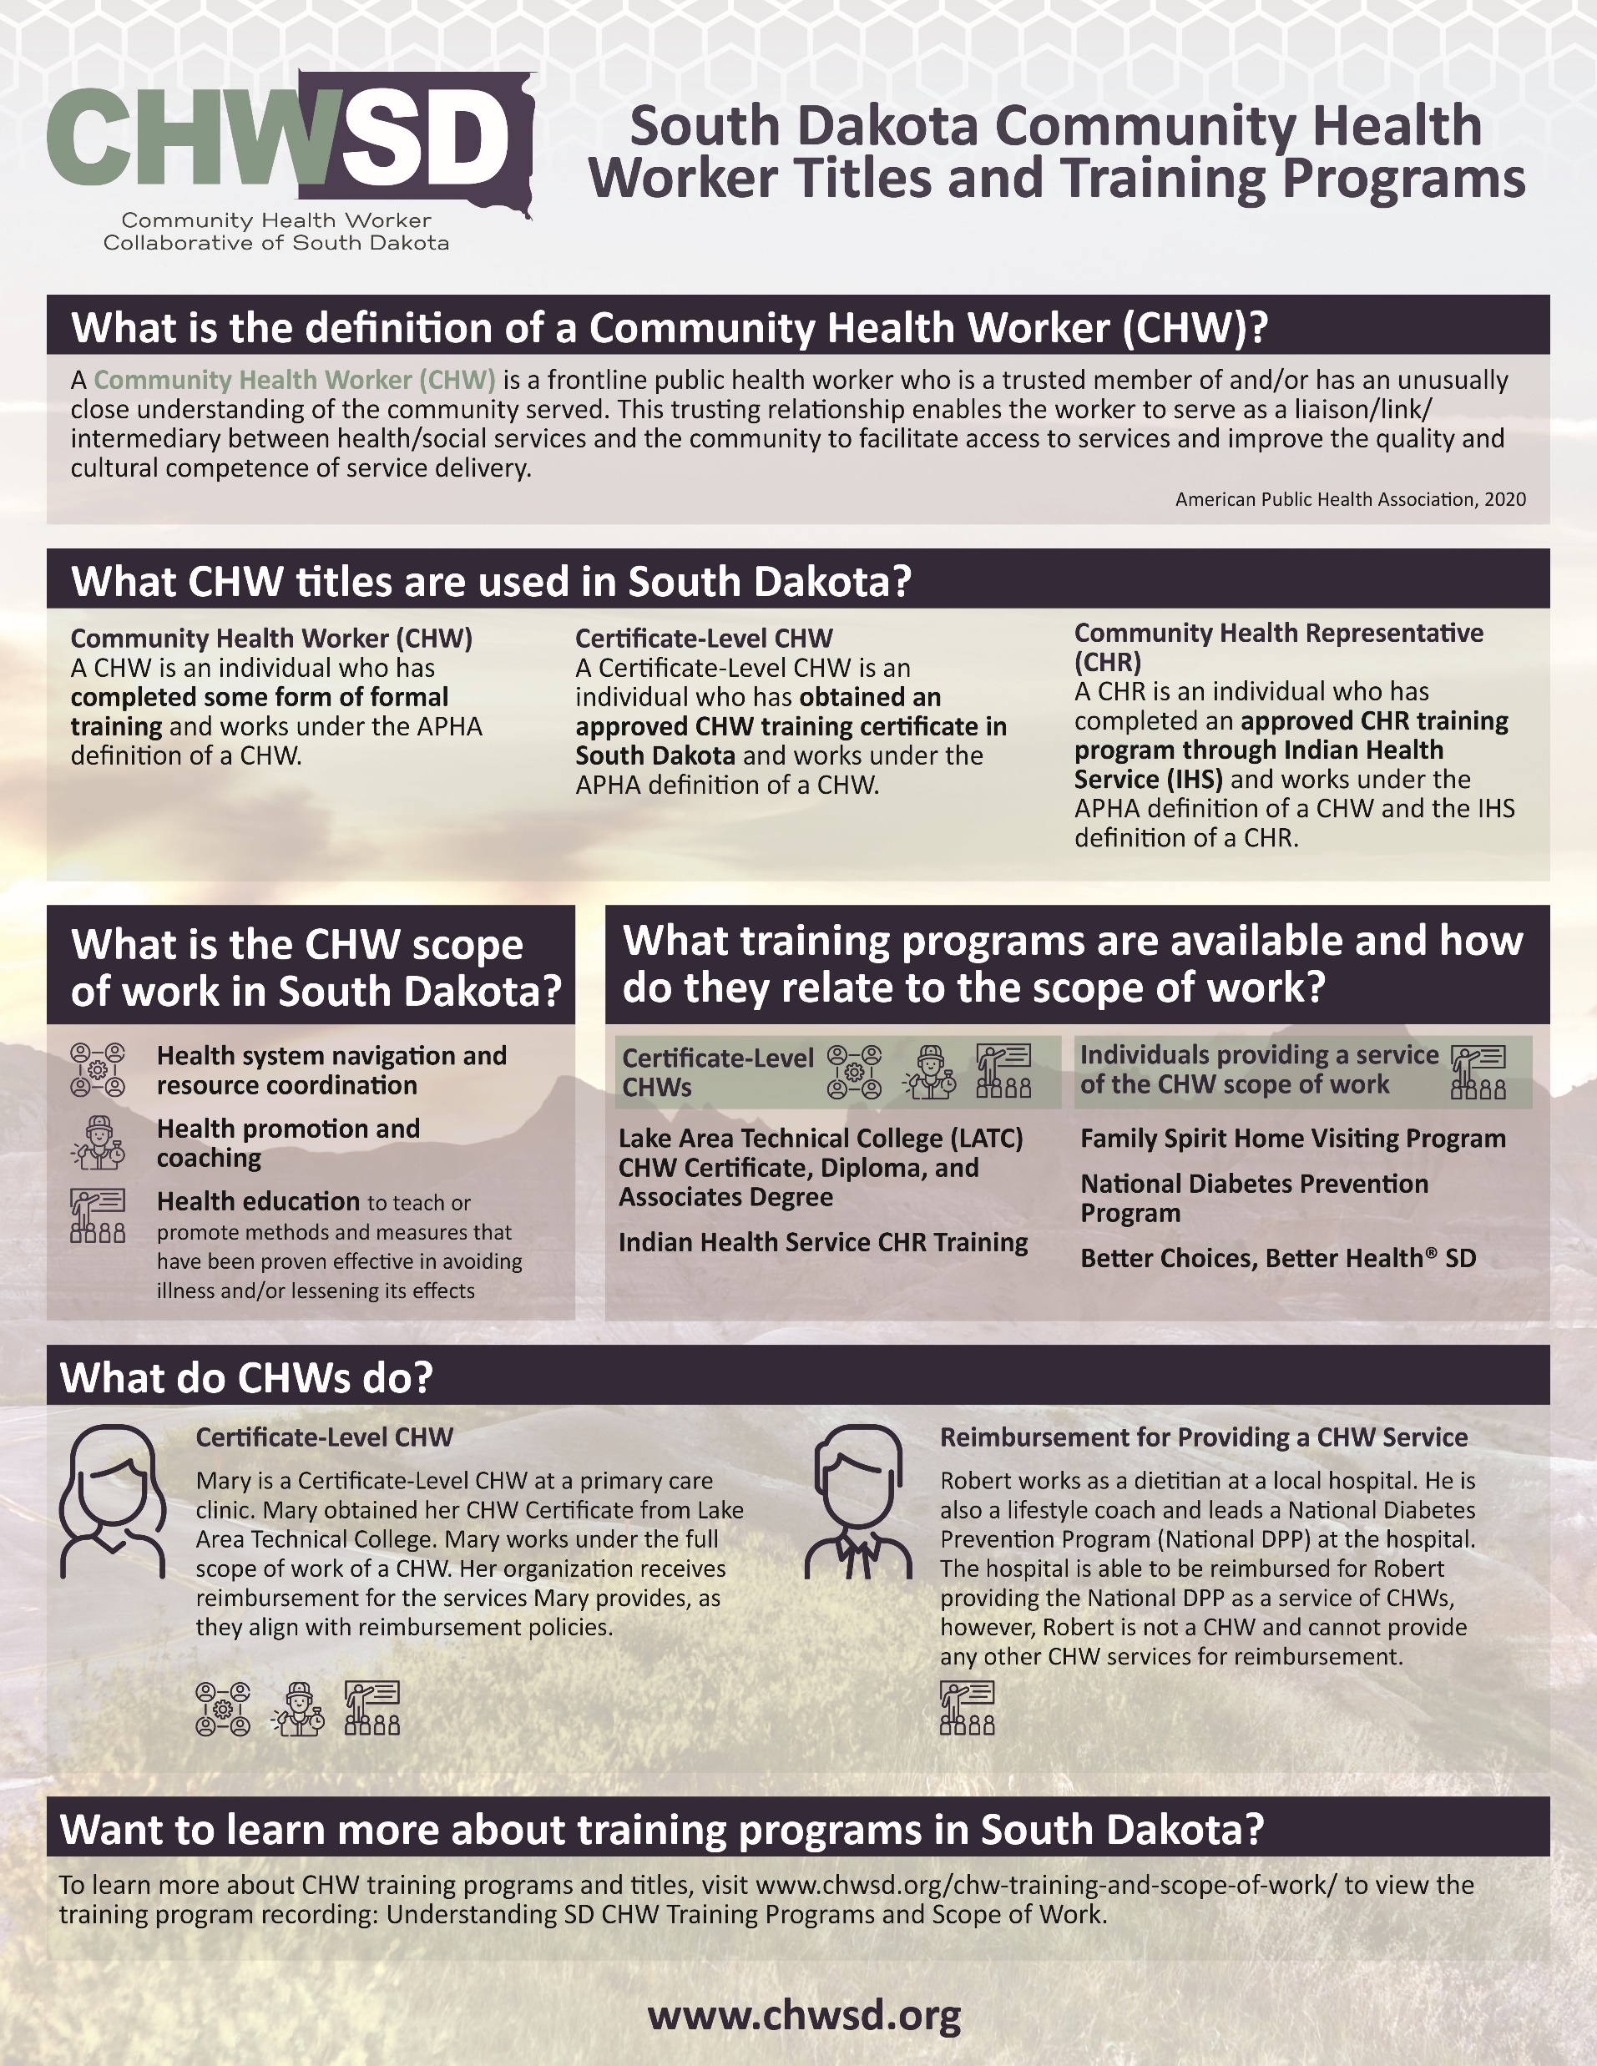
Training Programs Certificate-Level and Specified Training Programs (Cont.)
How Specified Training Programs Tie to Reimbursement
CHWs can train in these programs to expand the services they are able to provide (specifically in a group setting)
Individuals who have trained to lead these programs (i.e., a dietitian training as a Lifestyle Coach for the National DPP) could be reimbursed as providing a service of the CHW Scope of Work using the appropriate CPT code.
https://chwsd.org/chw-training-and-scope-of-work/

Slide 12
Mission and Vision Community Health Worker Collaborative of SD
Mission
To promote, support, and sustain the Community Health Worker (CHW) profession in South Dakota.
Support
The CHWSD is an extension of the South Dakota Department of Health, Office of Chronic Disease Prevention and Health Promotion

Slide 13
Organizational Origins Timeline of CHW Activities
2015
South Dakota Department of Health (SD DOH) conducted an environmental scan and statewide analysis of the CHW workforce
2016
SD DOH and SD DSS facilitated a workgroup to develop recommendations for CHWs in South Dakota
2019
SD DSS announced CHW services as a covered services of SD Medicaid
2020
SD DOH introduces CHWSD to promote and develop the CHW Workforce in South Dakota. CHWSD 2021 – 2023 Strategic Plan developed.
2021
Begin to develop a sustainable CHW workforce in South Dakota

Slide 14
South Dakota-Specific CHW Planning and Assessment Toolkit

Slide 15
CHW Toolkit (w/FREE CEUs)
4-Module Toolkit to learn more
Self-Guided Resource Version and CEU Version (2 FREE CEUs)
CME
CNE
EMS
Social Work
BAPP
Pharmacy
Dentistry
Counselors
General Certificate
https://chwsd.org/chw-toolkits/

Slide 16
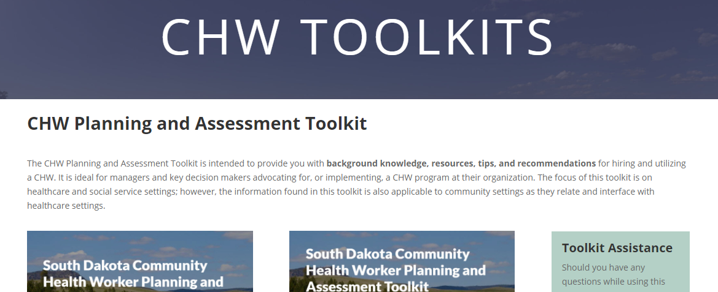
CHW Toolkit Modules
Module 1 – CHW Background
Module 2 – Planning
Module 3 – Implementation
Module 4 – Evaluation and Sustainability

Slide 17
CHWSD Financial Support (Coming Soon) CDC COVID-19 Health Disparities Grant
Organizational Investments
Organizational Funding
Health Systems (3)
Hospitals, Clinics, and other healthcare-related organizations
Community-based organizations
FQHCs
Dental
Training programs
300+ funding opportunities (up to $50,000 per SFY) to fund*:
Clinical/Healthcare-based CHW Program
Community-based CHW Program
Career Lattice/Cross-trained CHW Program
*Forecasted availability beginning September 2021

Slide 18
Next Steps Private Payer Reimbursement
Private Payer Reimbursement
3 Private Payers (Insurance Companies in South Dakota)
2 of 3 owned by health systems
Focus on full-circle work related to CHWs

Slide 19
Contact Information
Community Health Worker Collaborative of South Dakota
www.chwsd.org
605-937-9730
ben@chwsd.org

Slide 20
Sources
American Public Health Association. 2020. https://www.apha.org/apha-communities/member-sections/community-health-workers
South Dakota Department of Social Services. 2021. https://dss.sd.gov/docs/medicaid/providers/billingmanuals/Community%20Health%20Worker%20Services.pdf

