Slide 1
Missouri Community Health Worker Program and Social Determinants of Health (SDOH) Angela Herman-Nestor, MPA, CPHQ, PCMH-CCE Quality and Performance Improvement Manager

Slide 2
Missouri Community Health Worker Program Overview
Funding is provided to MO CHCs by the Department of Social Services
CHW services provided under the contract can be provided to any patient with MO HealthNet coverage.
24 CHCs in the CHW program
Notes:
MO HealthNet Coverage: Fee for Service, Managed Care, and dual eligible patients

Slide 4
Missouri Community Health Worker Program
Notes:
Program utilizes the Community Health Worker definition developed by the American Public Health Association and endorsed by the Department of Health and Senior Services.
Follow DHSS CHW Core Competencies
Promote training programs at one of the community colleges utilizing the curriculum developed/endorsed by the DHSS State

Slide 5
Missouri Community Health Worker Program
Notes:
CHWs will become a valuable member of the FQHC care team and serve as a liaison to the patient.

Slide 6
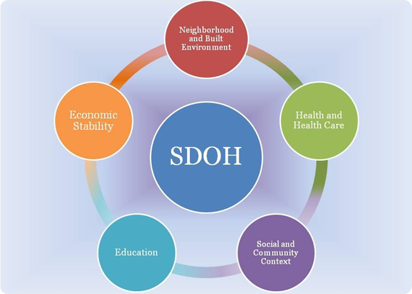
Healthy People 2020 SDOH Categories

Slide 7
HP2020 SDOH Categories
Each of these five determinant areas reflects a number of key issues that make up the underlying factors in the arena of SDOH.

Slide 8
Protocol for Responding to and Assessing Patients’ Assets, Risks, and Experiences (PRAPARE)

Slide 9
Protocol for Responding to and Assessing Patients’ Assets, Risks, and Experiences (PRAPARE)
What is PRAPARE?
national effort to help health centers and other providers collect the data needed to better understand and act on their patients’ social determinants of health.
consists of a set of national core measures as well as a set of optional measures for community priorities.
informed by research, the experience of existing social risk assessments, and stakeholder engagement
aligns with national initiatives prioritizing social determinants (e.g., Healthy People 2020), measures proposed under the next stage of Meaningful Use, clinical coding under ICD-10, and health centers’ Uniform Data System (UDS).
PRAPARE emphasizes measures that are actionable
PRAPARE Electronic Health Record templates have been developed or are currently under development.

Slide 10
PRAPARE Measures
PRAPARE Core Measures
Race | Education
Ethnicity | Employment
Migrant and/or Seasonal Farm Work | Insurance
Veteran Status | Income
Language | Material Security
Housing Status | Transportation
Housing Stability | Social Integration and Support
Address/Neighborhood | Stress
PRAPARE Optional Measures
Incarceration History | Safety
Refugee Status | Domestic Violence
Notes:
Will be updated as HRSA data collection requirements change such as Sexual Orientation Gender Identity (SOGI)

Slide 11
PRAPARE
PRAPARE is the dominant social risk identification strategy used by health centers nationally to improve patient and population health and is also being used by many other health care providers and systems. PRAPARE is unique in that:
It is FREE and is paired with a free PRAPARE Implementation and Action Toolkit (www.nachc.org/prapare) to guide users on how to implement PRAPARE in various workflows and respond to needs as they are identified.
It is both evidence based and stakeholder driven—developed and tested by health centers and designed to fit within existing workflows.
It is one of the only standardized social determinant of health screening tool built into multiple Electronic Health Record platforms.

Slide 12
PRAPARE Tool Kit
Latest versions of the PRAPARE tool and resources can be found on the NACHC website at the following location: http://www.nachc.org/research-and-data/prapare/
Link to latest PRAPARE Assessment: http://www.nachc.org/wp-content/uploads/2016/09/PRAPARE_One_Pager_Sept_2016.pdf
EMR templates have been developed or are in the process of being developed. See chapter four of the tool kit for additional information on EMR templates.

Slide 13
PRAPARE in DRVS
Azara is utilizing PRAPARE as the SDOH that is available in DRVS.
25 PRAPARE questions are grouped into 8 categories.
PRAPARE questions must be documented in structured fields in EMR.
After have one month of documentation in EMR submit a support ticket to Azara to allow mapping of where the questions are documented in the EMR.
SDOH Information from PRAPARE is available in four places in DRVS: SDOH registry, Patient Visit Planning Report Alerts, and Care Management Passport Alerts
Please note until you map all PRAPARE questions to DRVS only the UDS demographic information will populate the SDOH Registry and alerts.

Slide 14
Notes:
9 of 25 Data elements are already collected as part of UDS (Federal Uniform Data System reporting required by all health centers)

Slide 15
NCQA 2017 Includes Social Determinants of Health
Assessing and Addressing Social Determinants of Health is included as a component of both core and elective competencies in the 2017 NCQA Standards.
Use of the NACHC PRAPARE tool will assist practices in meeting the requirements for assessing and addressing Social Determinants of Health.
Use of the Pre Visit Planning Report, Care Management Passport, SDOH registry, and from DRVS can assist with care planning for patients

Slide 17
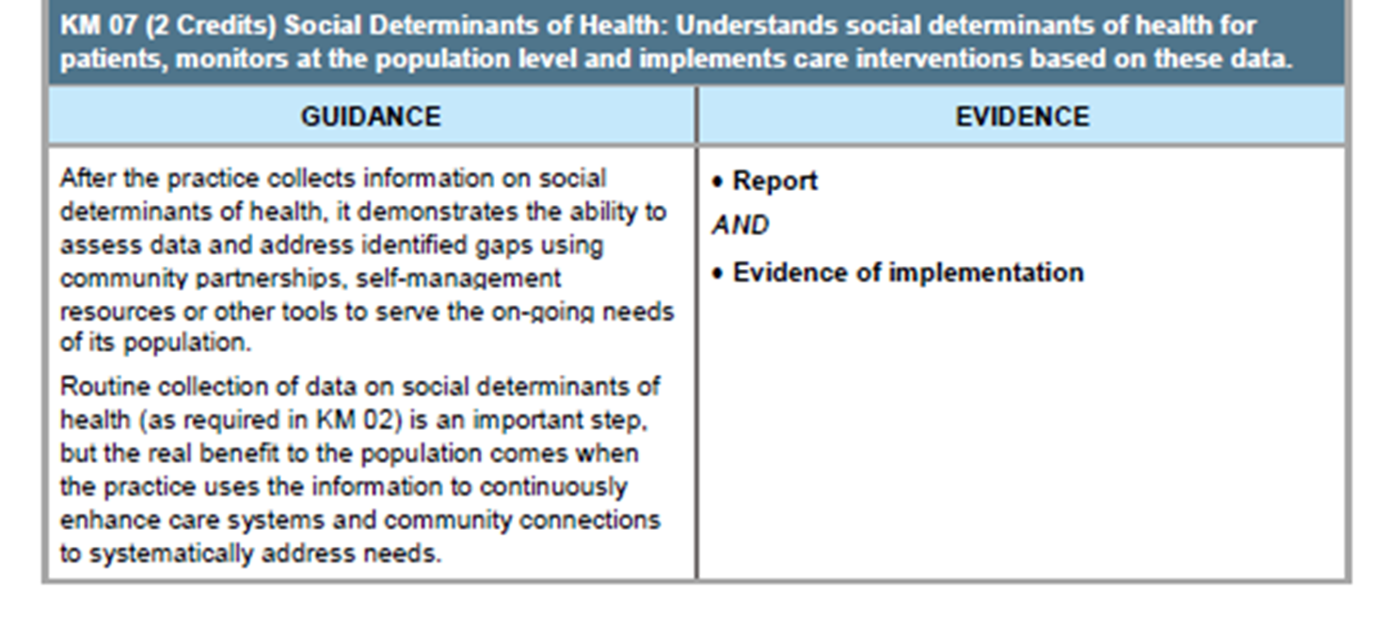

Slide 18
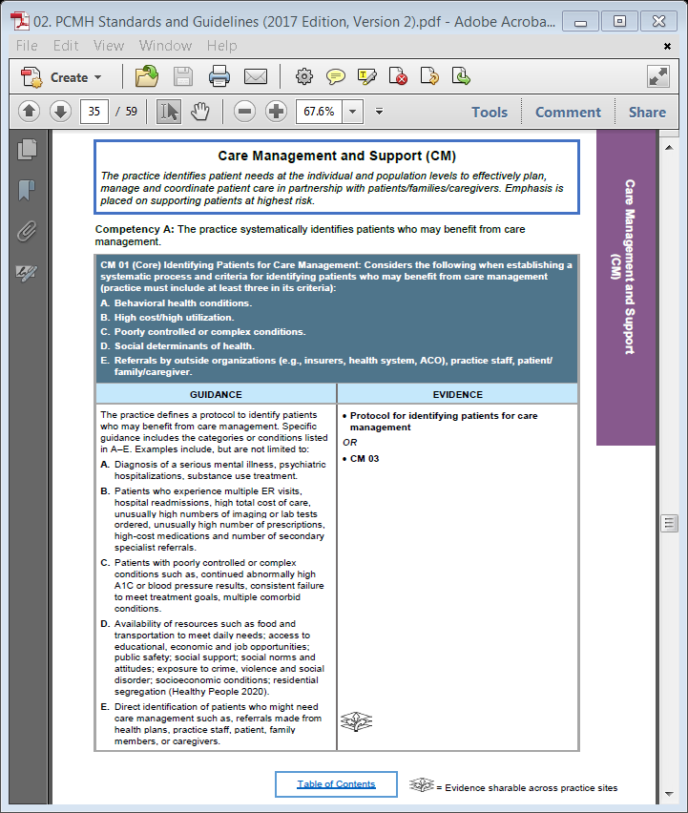

Slide 19
CHW Resources
Missouri Primary Care Association CHW section of website: www.mo-pca.org/chw
The Community Health Worker Core Consensus (C3) Project: 2016 Recommendations on CHW Roles, Skills, and Qualities
Making The Case For Community Health Workers On Clinical Care Teams: A Toolkit
Michigan Primary Care Association Community Health Worker Toolkit: http://www.mpca.net/page/chwtoolkit

Slide 20
Contact Information
Angela Herman-Nestor, MPA, CPHQ, PCMH-CCE
Quality and Performance Improvement Manager
3325 Emerald Lane
Jefferson City, MO 65109
573-636-4222
aherman@mo-pca.org

